Slide 1


AyurAuth - A Blockchain-Driven System for Authenticity, Sustainability and Export Readiness of Ayurvedic Herbs
Under the guidance of: Prof. Jayesh Rane and Vijen Gala
Aditya Rajesh Srinivas — 16014022115
Shreya Vikas Jhamb — 16014022121
Slide 1 of 18 AyurAuth | Aditya Rajesh Srinivas & Shreya Vikas Jhamb
Slide 1 of 17

Slide 2
Outline
Sr. No. | Topic / Chapter Title | Page No.
1 | Introduction & Background | 3
2 | Literature Survey | 4-5
3 | Problem Statement | 6
4 | Objectives of the Project | 7
5 | System Architecture | 8
6 | Tech stack | 9
7 | System Workflow | 10
8 | Methodology and Proposed Approach | 11
9 | 4 Stage Pipeline | 12
10 | AI Chatbot and CNN Model | 13
11 | Work Done (Frontend + Full Stack) | 14
12 | Implementation Screenshots | 15-16
13 | References | 17
Slide 2 of 17

Slide 3
Introduction
Ayurveda is one of the world’s oldest holistic healing systems existing in India for more than 5000 years ago. Today as the global Ayurvedic industry is expanding rapidly it is constantly driven by increasing demand for organic, natural and plant-based healthcare solutions.
Despite this growth, existing platforms such as e-Aushadhi and e-Charak remain fragmented and it is seen that there exists a lack a unified ecosystem. Currently, there is no scalable, technology-driven and export-ready solution that ensures transparency, authenticity and traceability within the Ayurvedic supply chain.
Recognizing this gap, we began exploring the intersection of technology and Ayurveda. Our research focused on identifying how modern technologies such as Artificial Intelligence, QR-based traceability and blockchain-inspired verification systems could be integrated to create a smarter and more reliable Ayurvedic ecosystem.
In order to build a strong foundation for our work we analyzed and reviewed multiple research papers and existing solutions in this domain
Slide 3 of 17
Slide 3 of 18 AyurAuth | Aditya Rajesh Srinivas & Shreya Vikas Jhamb

Slide 4
Literature Survey
Ref | Paper Name | Model / Technique | Dataset Used | Strengths | Limitations
1 | Comparative Study of Convolutional Neural Networks for Leaf Classification in Ayurveda | Convolutional Neural Networks (VGG-16, ResNet-50, EfficientNet-V2M) | 1,835 images of 30 Ayurvedic plant species | EfficientNet-V2M achieved 98.24% accuracy with fast training time | Performance varies with lighting conditions and complex backgrounds
2 | End-to-End Traceability in Ayush Drug Supply Chains: Challenges, Opportunities, and Policy Perspectives | Artificial Intelligence enabled Blockchain with Quick Response Codes | Analysis of e-Aushadhi and e-Charak portals | Provides comprehensive regulatory roadmap for global compliance standards | Largely conceptual and requires significant infrastructure in rural areas
3 | Leveraging Deep Learning and Blockchain for Enhanced Transparency and Traceability in the Indian Herbal Product Supply Chain | Hyperledger Fabric Blockchain with Sequential Convolutional Neural Network | 20-class medicinal plant image dataset | Enables real-time tracking and prevents data tampering through immutable ledger | Lower classification accuracy compared to standalone deep learning models
4 | Segmented Encryption: A Quality and Safety Supervisory Model for Herbal Medicine Based on Blockchain Technology | Blockchain Technology with Smart Contracts and Radio Frequency Identification / Quick Response Codes | Global herbal product lifecycle data | Provides secure seed-to-shelf monitoring with high transparency | High implementation cost for small-scale farmers and producers
5 | MedicLedger: Blockchain-Based Supply Chain Architecture for Ayurvedic Product Authentication and Compliance | Decentralized Ethereum Blockchain Network | Transactional data of herbal raw materials | Eliminates intermediaries and ensures fair pricing for farmers | Scalability challenges and high transaction (gas) fees
Slide 4 of 17
Slide 5 of 18 AyurAuth | Aditya Rajesh Srinivas & Shreya Vikas Jhamb

Slide 5
Literature Review
Ref | Paper Name | Model / Technique | Dataset Used | Strengths | Limitations
6 | DNA Barcoding of the Market Samples of Single-Drug Herbal Powders Reveals Adulteration with Taxonomically Unrelated Plant Species | DNA Barcoding using ribulose-bisphosphate carboxylase (rbcL) marker | 107 single-drug herbal powder samples covering 65 species | Highly accurate identification of species even in processed powders | Requires expert laboratory setup and high-quality genomic DNA
7 | Traceability System for Rare Chinese Herbal Medicines Based on Blockchain Structure | Double Blockchain Architecture (Private Blockchain and Consortium Blockchain) with InterPlanetary File System | Multi-modal supply chain records including images and transaction logs | Efficient storage of large files off-chain while maintaining secure logs | Increased technical complexity due to dual blockchain architecture
8 | Demystifying Hyperledger Fabric Framework for Distributed Ledgers and Approach to Evaluate Its Performance | Permissioned Blockchain using Hyperledger Fabric Framework | Simulated multi-organization network transactions | Provides high throughput, low latency, and strong privacy control | Requires advanced technical expertise for setup and maintenance
9 | Integrating Artificial Intelligence and Data Analytics for Supply Chain Optimization in the Pharmaceutical Industry | Artificial Intelligence with Predictive Data Analytics and Blockchain Integration | Historical production, demand, and distribution datasets | Enables accurate demand forecasting and secure supply chain optimization | Requires large volumes of high-quality historical data
10 | HerBChain, a Blockchain-Based Informative Platform for Quality Assurance and Quality Control of Herbal Products | Consortium Blockchain using Openchain Framework with Quick Response Codes | Six-stage herbal product manufacturing lifecycle data | Minimizes manipulation of quality records across stakeholders | Faces resistance in adoption among traditional industry participants
Slide 5 of 17
Slide 7 of 18 AyurAuth | Aditya Rajesh Srinivas & Shreya Vikas Jhamb

Slide 6
Problem Statement
"A Blockchain driven system for authenticity, sustainability and export readiness of ayurvedic herbs"
The problem statement was formulated with the objective of creating a better outreach and a centralized platform for Ayurvedic herbs by effectively utilizing modern technological tools and solutions. The aim was to develop a one-stop digital platform that simplifies access to information, authentication and guidance related to Ayurvedic herbs.
After conducting a thorough research survey and analysis, we identified several key challenges and problem areas, which are as follows:
1. No end-to-end traceability system: We saw that supply chain blind spots from farm to consumer.
2. Fragmented digital platforms: It showed that existing platforms like e-Aushadhi and e-Charak do not communicate.
3. No export compliance automation: No existing system helps in doing regulatory compliancet for EU FMD or US DSCSA.
4. No real-time sustainability tracking i.e environmental metrics are completely absent (its not SDG inclusive)
5. Limited inclusion of small farmers: no accessible digital verification tools which could be used by the mass.
6. Lack of authenticity verification: There is no physical or AI-based visual cross check at point of upload to see whether its valid or invalid.
Slide 6 of 17
Slide 4 of 18 AyurAuth | Aditya Rajesh Srinivas & Shreya Vikas Jhamb

Slide 7
Objectives of the Project
1. Implement blockchain traceability using Polygon for tamper-proof herb tracking.
2. Evaluate system performance with parameters like benchmark throughput, latency, scalability.
3. Develop AI herb authentication using CNN (MobileNetV2), ~85% accuracy across 10 herb classes.
4. Enable geo-tagging using the Browser Geolocation API, no IoT hardware required.
5. Implement QR code verification (jsQR) camera scan, image upload or manual Batch ID entry.
6. Design a mobile-first, multilingual React 18 SPA supporting 10 languages via react-i18next.
7. Integrate an NLP AI chatbot for real-time user assistance accessible from every page.
8. Incorporate export compliance aligned with EU Falsified Medicines Directive and US DSCSA.
Slide 7 of 17
Slide 8 of 18 AyurAuth | Aditya Rajesh Srinivas & Shreya Vikas Jhamb

Slide 8
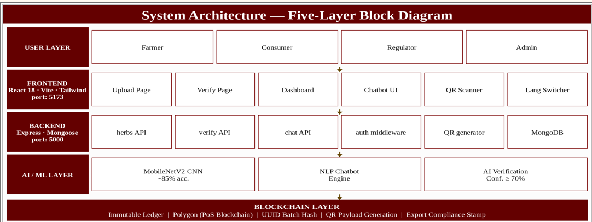
System Architecture: Block Diagram
Slide 8 of 17
Slide 9 of 18 AyurAuth | Aditya Rajesh Srinivas & Shreya Vikas Jhamb

Slide 9
TECH STACK USED
Tech Stack:
• React 18 + TypeScript + Vite + Tailwind CSS
• Node.js + Express + MongoDB (Mongoose ODM)
• CNN:- MobileNetV5 (~85% validation accuracy)
• NLP AI Chatbot (keyword + intent engine)
• QR Code Verification (jsQR — camera + upload)
• Polygon (blockchain simulation)
• react-i18next — 10 languages supported
Slide 9 of 17

Slide 10
System Workflow — End-to-End Flow
Five-layer architecture:
Layer 1 — User Layer
Farmers upload herb details and images
Consumers verify authenticity using QR codes
Regulators and admins monitor the system
Layer 2 — Frontend Layer
Built using React 18 and Tailwind CSS
Provides upload, verification, and dashboard modules
Includes chatbot and QR scanner functionality
Layer 3 — Backend Layer
Developed using Express.js and MongoDB
Handles herb, verification, and chatbot APIs
Stores batch records and blockchain transaction hashes
Layer 4 — AI / ML Layer
Uses MobileNetV2 CNN for herb authentication
NLP chatbot provides real-time assistance
AI verifies herbs with ≥70% confidence threshold
Layer 5 — Blockchain Layer
Uses Polygon blockchain for secure traceability
Generates immutable transaction hashes for batches
Enables transparent QR-based verification system
Main Pipeline:
1. Capture → image + metadata
2. Geo-Tag → lat/lng via browser API
3. AI Verify → CNN ≥70% threshold
4. Blockchain → UUID hash sealed
5. QR Code → payload generated
6. Consumer → scan to verify
AI Chatbot Flow (parallel, all pages):
Message → NLP → /api/chat → MongoDB → Response
Fallback: local keyword replies if backend is offline
QR Verification Flow:
Scan → Decode → /api/verify → DB → Status Banner
Slide 10 of 17
Slide 10 of 18 AyurAuth | Aditya Rajesh Srinivas & Shreya Vikas Jhamb

Slide 11
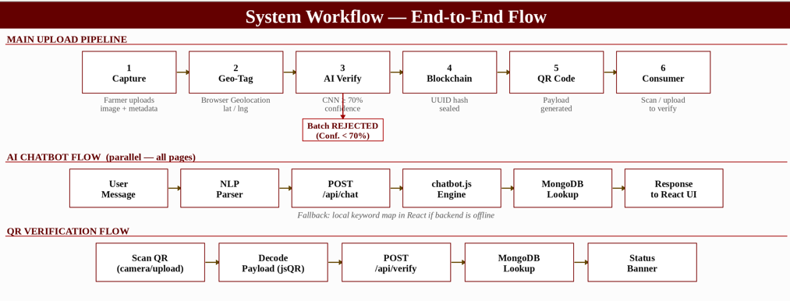
Methodology & Proposed Approach
Slide 11 of 17
Slide 11 of 18 AyurAuth | Aditya Rajesh Srinivas & Shreya Vikas Jhamb

Slide 12
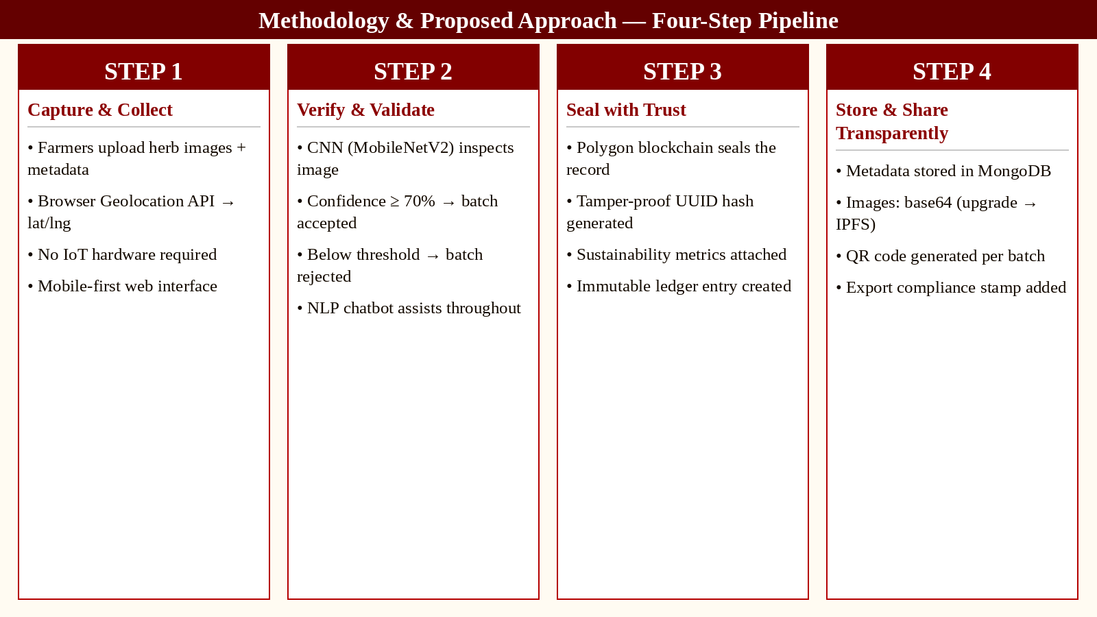
4 staged pipeline
Slide 12 of 17
Slide 12 of 18 AyurAuth | Aditya Rajesh Srinivas & Shreya Vikas Jhamb

Slide 13
AI Chatbot & CNN model
CNN MODEL
Architecture Pipeline:
Input (224×224×3) → MobileNetV2 Base (frozen)
→ Unfreeze last ~30 layers → GlobalAvgPool2D
→ Dense 256 (ReLU, Dropout 0.5)
→ Dense 128 (ReLU, Dropout 0.3)
→ Softmax Output (10 herb classes)
Training:
1,300+ images | 80/20 split | 50 epochs
Adam lr=0.0001 | Early stopping patience=5
Augmentation: Rotation, Zoom, Flip, Shear, Brightness
Results:
~85% validation accuracy
Confusion Matrix | Precision / Recall / F1 per class
AI CHABOT
Pipeline:
User Message → NLP Parser → POST /api/chat
→ chatbot.js (rule-based) → MongoDB lookup
→ Response streamed to React UI
Fallback: local keyword map (works offline)
Frontend Components:
AIChatbot.tsx — floating widget, all pages
ChatPage.tsx — full screen at /chat (login required)
useTranslation() — localised in 10 languages
NLP Engine (chatbot.js):
Intents: upload | verify | blockchain | AI | workflow
Context: MongoDB herb records for batch-specific answers
Upgrade path: swap for LLM API (Anthropic / OpenAI)
Slide 13 of 17
Slide 13 of 18 AyurAuth | Aditya Rajesh Srinivas & Shreya Vikas Jhamb

Slide 14
Work Done : Frontend & Full Stack
Frontend (React 18 + TypeScript + Vite)
8 pages built: Landing, Login, Signup, Upload, Verify, Dashboard, Consumer Dashboard, and Chat. The UI uses Tailwind CSS with dark mode, glassmorphism-style cards, and Framer Motion animations. Internationalization covers 10 languages — English, Hindi, Tamil, Gujarati, Bengali, Punjabi, Malayalam, Marathi, German, and French via react-i18next. The landing page has workflow cards that link directly to Upload, Dashboard, and Verify.
Auth & Forms
JWT-based login and signup with Zod validation (email format enforcement, strong password rules). Demo user seeding from backend/.env. Field errors clear correctly on Login, Signup, and Upload forms.
Upload & Traceability
Drag-and-drop image upload with automatic geo-location via the browser Geolocation API. Farmer and herb metadata capture. CNN verification via the Flask ML service. QR payload generation in the format ayurauth://batch/<uuid>. Dashboard table showing all uploaded batches. Success panel after upload that keeps the CNN result and QR image on screen.
Verify & QR System
jsQR-based camera scan, image-upload decode, and manual batch ID / QR paste. Status display showing valid, invalid, or unverified with full herb details.
Backend (Express + MongoDB)
7 REST endpoints at http://localhost:5000: GET /api/health, GET /api/herbs, GET /api/herbs/:id, GET /api/herbs/:id/qr-image, POST /api/herbs, POST /api/verify, POST /api/chat. MongoDB Atlas with DNS fix and local JSON fallback. Image storage via MongoDB or local uploads. QR generation, blockchain-style hashes, and validation schemas. Stack: Node.js, Express 4, Mongoose, uuid, qrcode, dotenv.
ML Service (Flask + TensorFlow)
herbal_auth_improved_final.h5 (224×224, MobileNetV2) is the primary model; leaf_model.h5 (160×160) is legacy. Auto-detects input size from the model. .env pins the correct model. Health endpoint on port 5001. Trained on 5 herb classes: Amla, Guava, Hibiscus, Neem, Tulsi. ~85% validation accuracy with Adam optimizer, early stopping, and augmentation (rotation, zoom, flip, shear, brightness).
AI Chatbot
Floating widget present on all pages plus a dedicated /chat page (login-gated). Topic-aware responses covering upload workflow, AI verification, QR, and blockchain. Optional Anthropic API key; rule-based fallback works offline. Information-only mode — no contact details or spam.
Slide 14 of 17
Slide 15 of 18 AyurAuth | Aditya Rajesh Srinivas & Shreya Vikas Jhamb

Slide 15
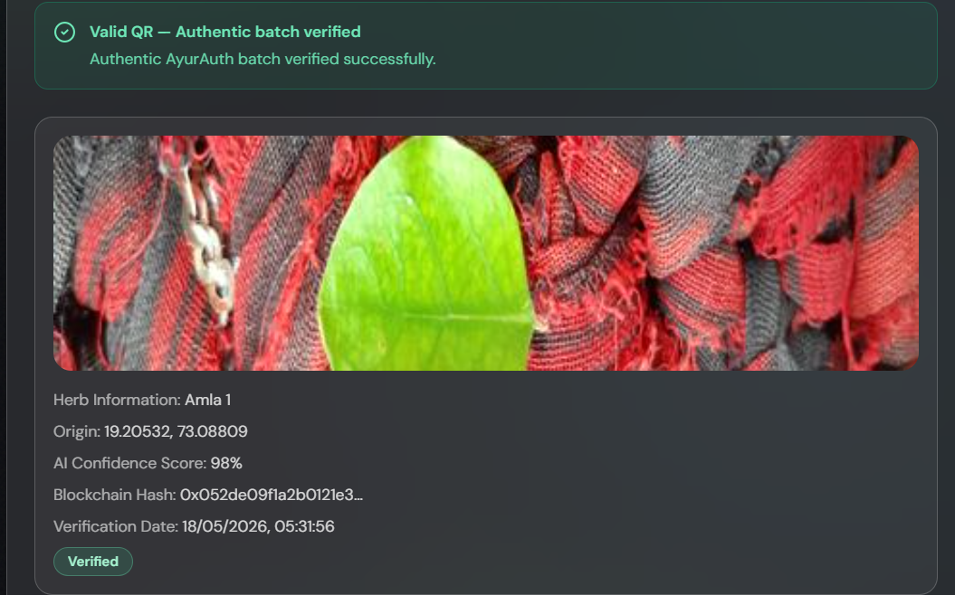
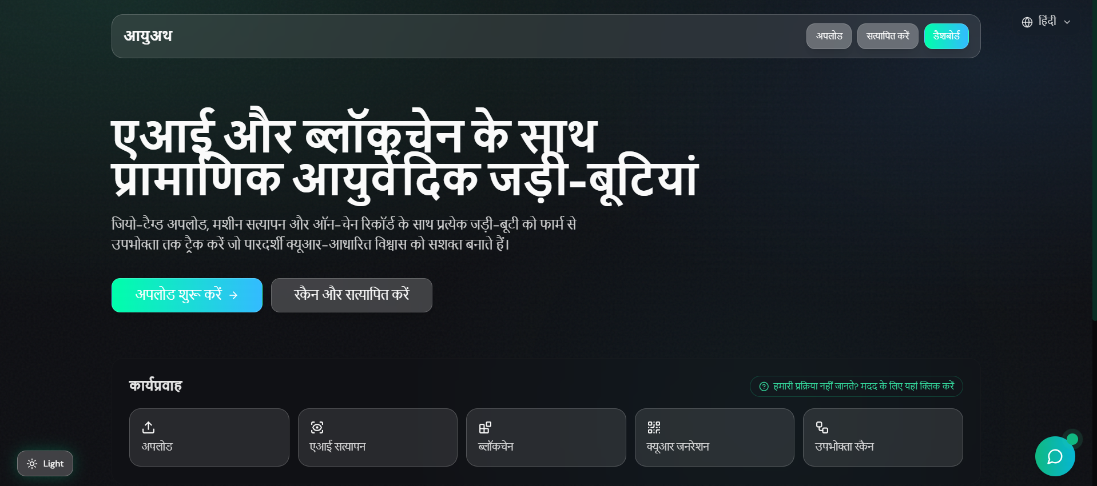
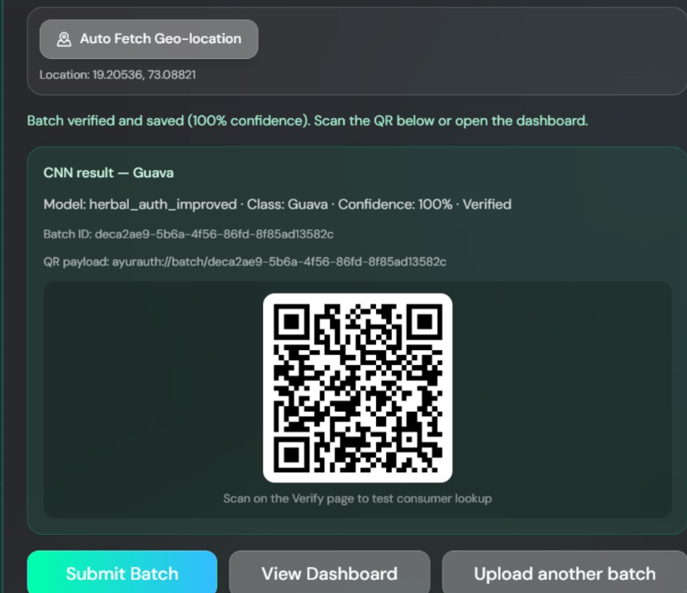
Implementation Screenshots
Slide 15 of 17
Slide 18 of 18 AyurAuth | Aditya Rajesh Srinivas & Shreya Vikas Jhamb

Slide 16
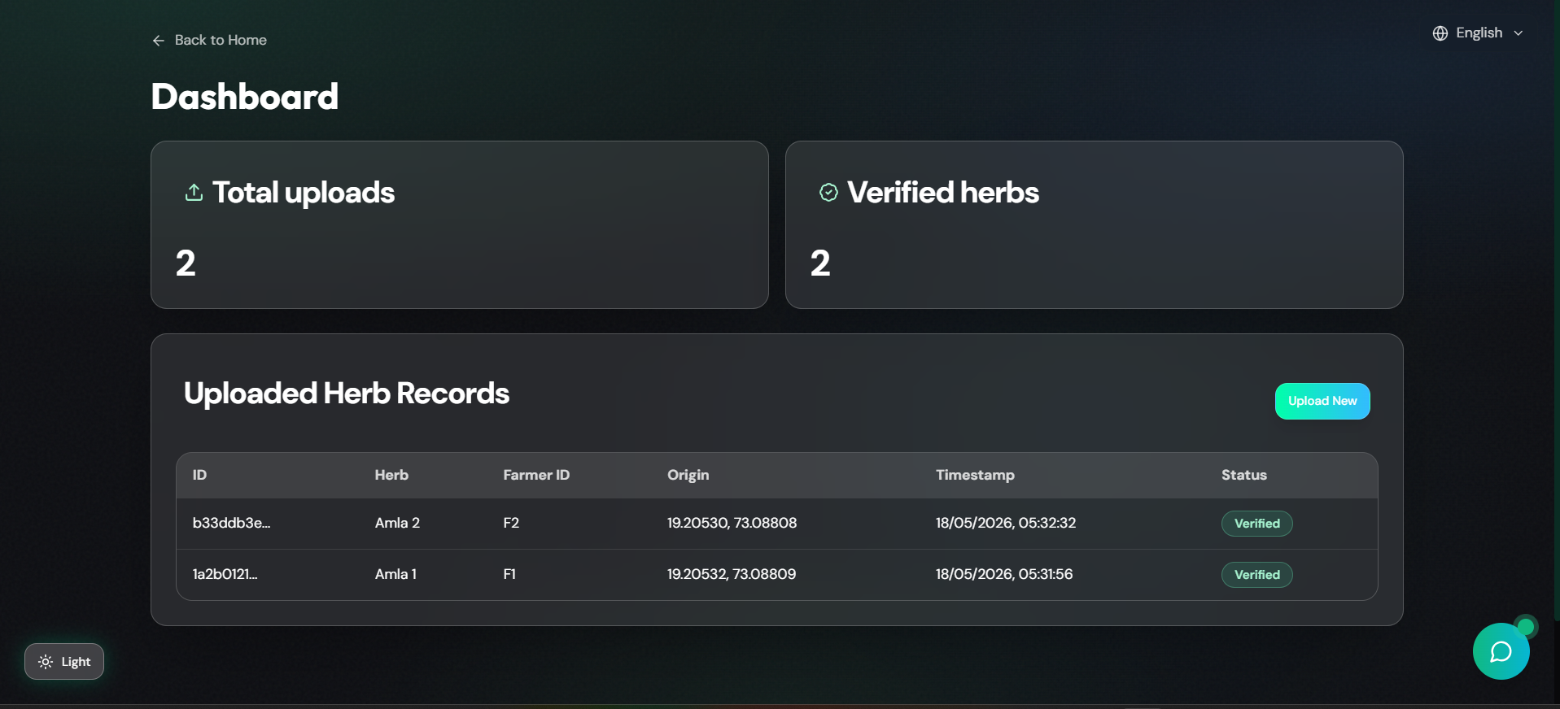
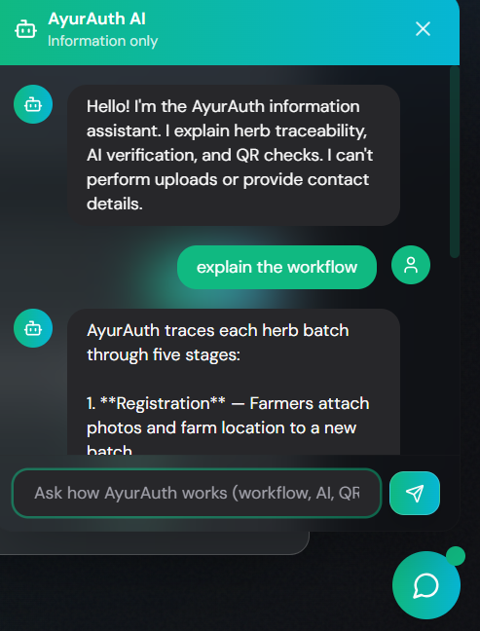
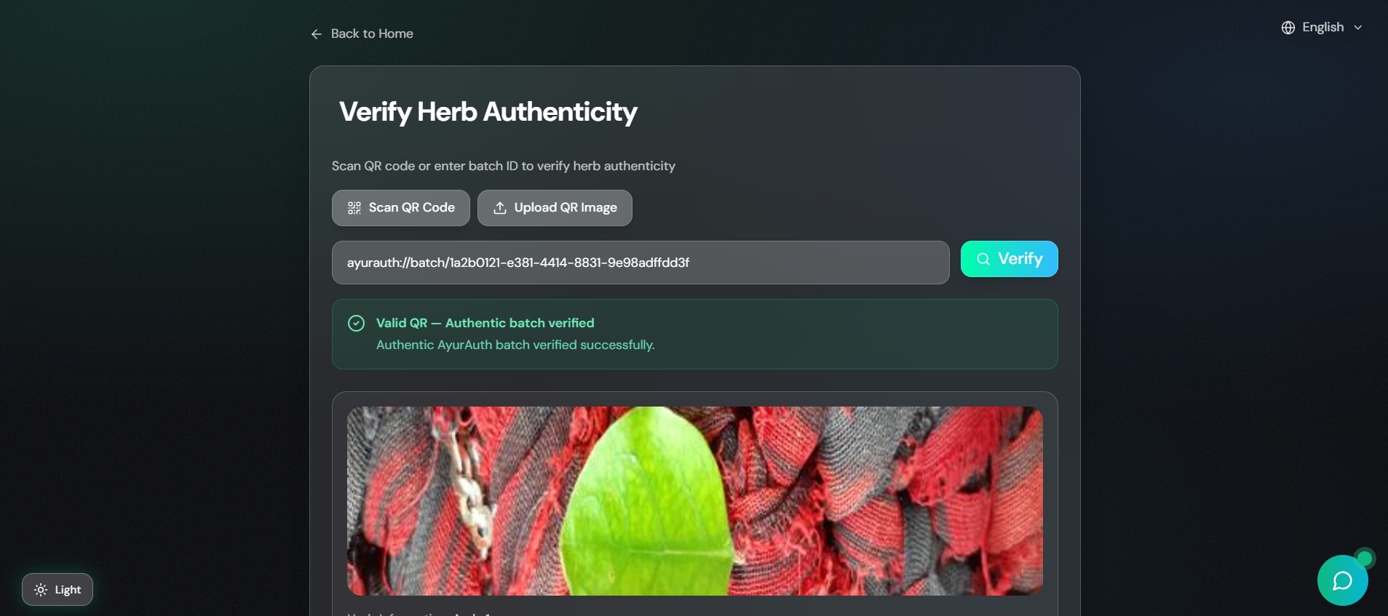
Implementation Screenshots
Slide 16 of 17
Slide 16 of 18 AyurAuth | Aditya Rajesh Srinivas & Shreya Vikas Jhamb

Slide 17
References
Kunjachan, S., Remya, R., Kumar, S., Asish, G. R., Sheela, K., & Kala, S. (2023). Comparative Study of Convolutional Neural Networks for Leaf Classification in Ayurveda. International Conference on Green Energy, Computing and Intelligent Technology (GEn-CITy 2023), 10–12 July 2023.
Kaushik, R., Kumar, S., & Pathak, S. (2025). End-to-end traceability in Ayush drug supply chains: Challenges, opportunities, and policy perspectives. International Journal of Ayurveda Research, 6(4), 379–386. https://doi.org/10.4103/ijar.ijar_318_25
Uniyal, P., Singh, C., & Dinesh, G. (n.d.). Leveraging Deep Learning and Blockchain for Enhanced Transparency and Traceability in the Indian Herbal Product Supply Chain. Dept of Computational Intelligence, School of Computing, SRM Institute of Science and Technology.
Liu, J., Peng, S., Luo, J., Tang, Z., & Liu, H. (2021). Segmented Encryption: A Quality and Safety Supervisory Model for Herbal Medicine Based on Blockchain Technology. IEEE International Conference on E-health Networking, Application & Services (HEALTHCOM).
Rout, S. K. (2025). MedicLedger: Blockchain-Based Supply Chain Architecture for Ayurvedic Product Authentication and Compliance. International Journal of Computer Engineering and Technology (IJCET), 16(1), 1706–1721. https://doi.org/10.34218/IJCET_16_01_125
Balaji, R., & Parani, M. (2022). DNA Barcoding of the Market Samples of Single-Drug Herbal Powders Reveals Adulteration with Taxonomically Unrelated Plant Species. Diversity, 14(495). https://doi.org/10.3390/d14060495
Liu, H., Dong, J., & Ge, S. (2021). Traceability System for Rare Chinese Herbal Medicines Based on Blockchain Structure. 3rd International Conference on Artificial Intelligence and Advanced Manufacture (AIAM), 382–385.
Kaushal, R. K., Kumar, N., Makka, S., & Saluja, K. (2023). Demystifying Hyperledger Fabric Framework for Distributed Ledgers and Approach to Evaluate Its Performance. International Conference on Sustainable Emerging Innovations in Engineering and Technology (ICSEIET), 116–120. https://doi.org/10.1109/ICSEIET58677.2023.10303377
Reddy, P. K., Mane, A., Islam, A., Singh, R., & Khatoon, F. (2024). Integrating artificial intelligence and data analytics for supply chain optimization in the pharmaceutical industry. International Journal of Intelligent Systems and Applications in Engineering, 12, 934–941.
Yik, M. H.-Y., Wong, V. C.-W. T., Wong, T.-H., & Shaw, P.-C. (2021). HerBChain, a blockchain-based informative platform for quality assurance and quality control of herbal products. Journal of Traditional and Complementary Medicine, 11(6), 598–600. https://doi.org/10.1016/j.jtcme.2021.07.005
Slide 17 of 17
Slide 18 of 18 AyurAuth | Aditya Rajesh Srinivas & Shreya Vikas Jhamb

